Slide 1
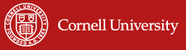
Facilitating the escape from risk-based poverty traps in rural Africa
Prof. Chris Barrett, Cornell University
March 11, 2025

Slide 2
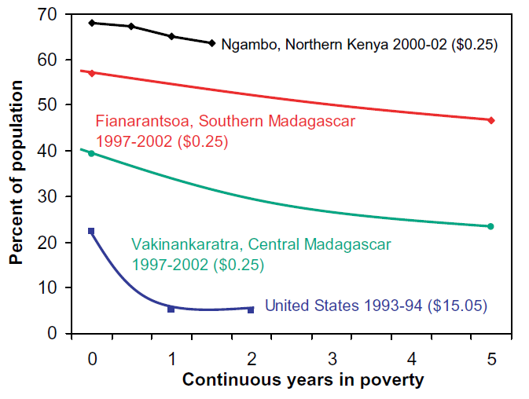
Depth, prevalence and persistence of poverty
The poorest places on the globe are defined not only by the depth and prevalence of poverty but equally by poverty’s persistence. We cannot estimate the half-life of poverty in these places in data.
Source: Barrett & Swallow (2006 WD)

Slide 3
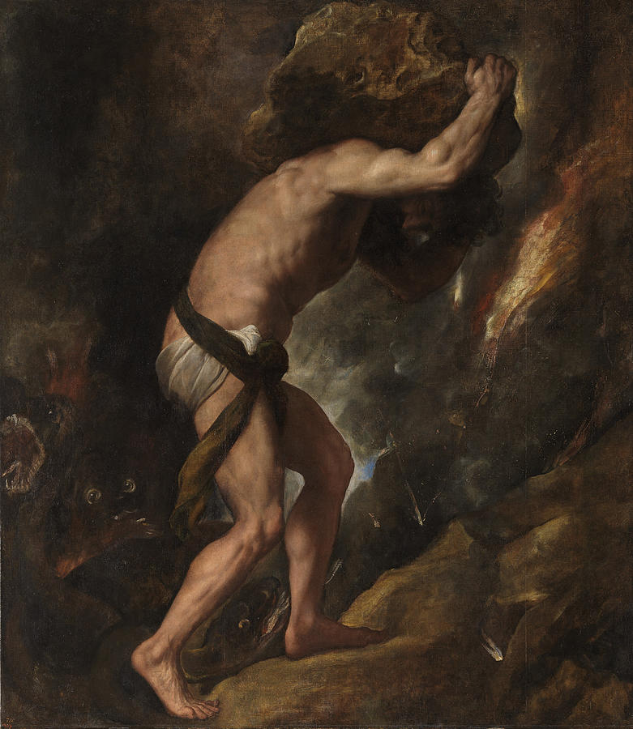

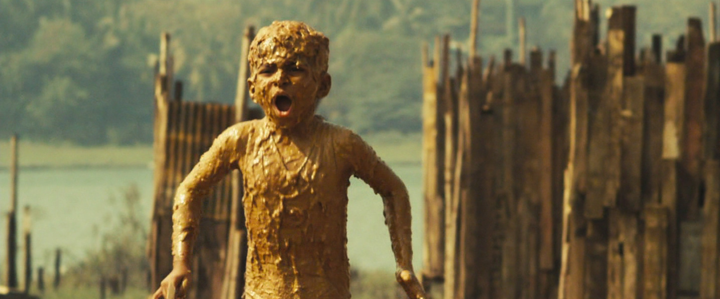
Why deep, persistent, prevalent poverty?
Poverty traps arise when people do their best but the odds are against them.
(Titian, Sisyphus, 1549)
People can escape against formidable odds … generates feel-good stories we celebrate.

Slide 4
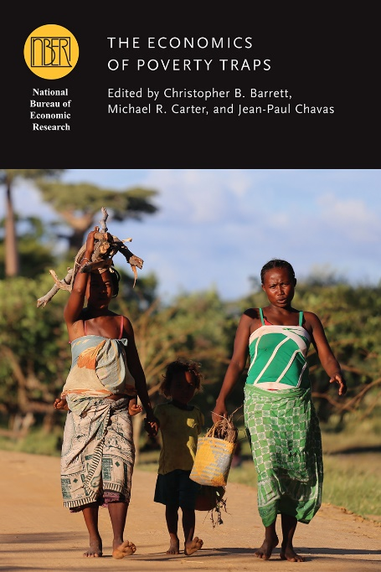
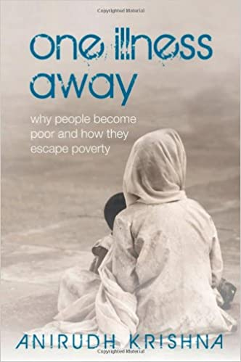
Why deep, persistent, prevalent poverty?
Emergent view of poverty traps emphasizes uninsured risk exposure.
The poor routinely face catastrophic risk exposure from various sources: minimal credit/insurance, police protections, preventive/curative health care, residential location, etc.
Poverty puts a premium on risk management.

Slide 5
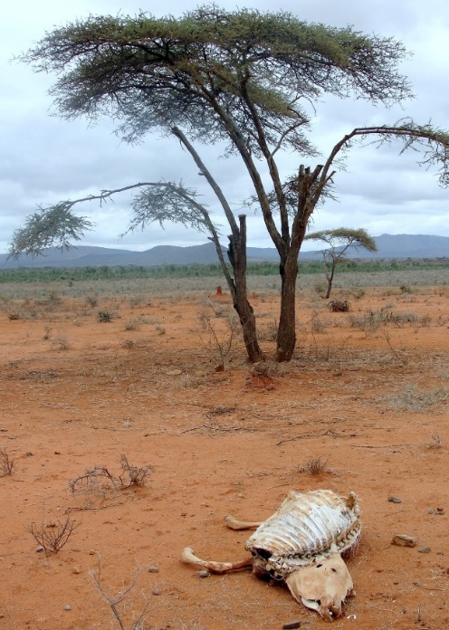
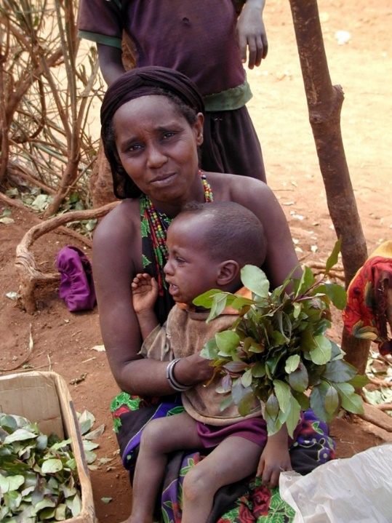
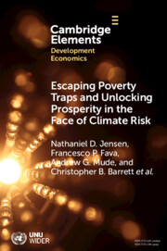
Example 1: Droughts, herders and
index-based livestock insurance (IBLI)
Poverty traps exist in the drylands of Kenya/Ethiopia. Catastrophic herd loss risk due to major droughts is the major cause of these dynamics and getting worse. Puts a premium on drought risk management, both for individuals and for society.

Slide 6
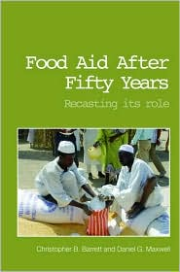
Standard responses to drought emergencies
Standard responses to major drought shocks:
1) Post-drought restocking (futile at low levels, Santos & Barrett 2019 NBER)
2) Food aid (slow, expensive, can reinforce sedentarization, lots of excess mortality due to US policies Nikulov et al. PLoS ONE 2016)

Slide 7
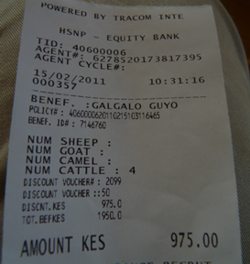
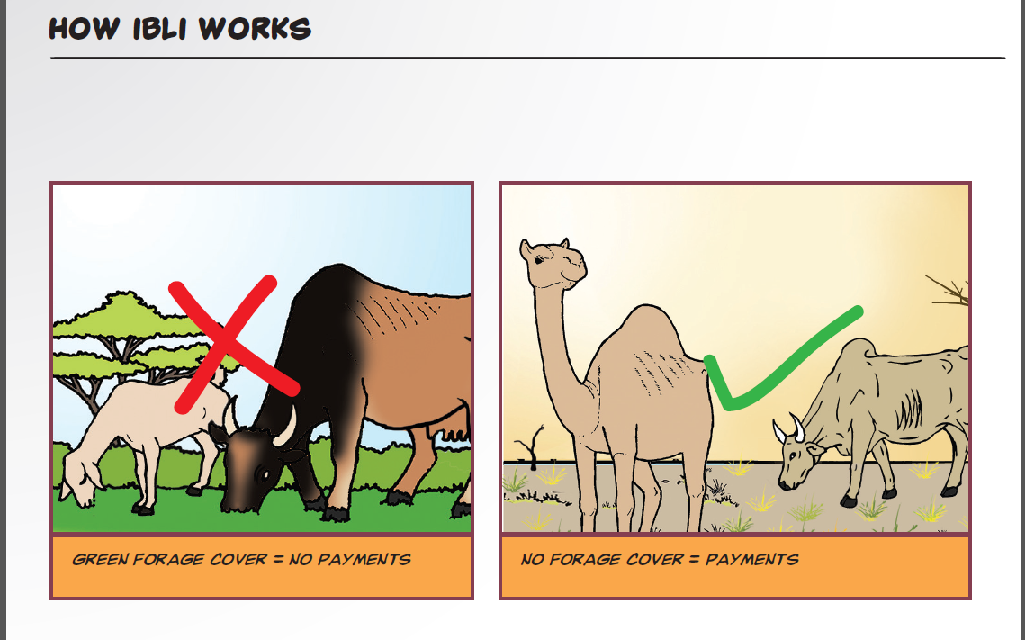
The index insurance possibility
Index-based livestock insurance – use satellite measures of rangeland conditions to predict herd losses and use historical data to statistically price the risk. Turn into a financial product.
Sold 2x/year, just before rains typically begin.
Chantarat et al. JRI 2013; Jensen et al. Ecol Econ 2019

Slide 8
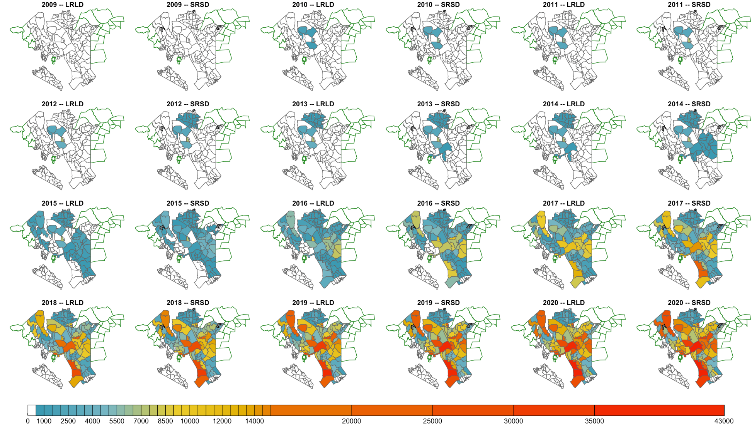
IBLI uptake significant …

Slide 9
(Jensen, Barrett & 2014)
A good, if imperfect approach
Hard to design the product and explain to people well. Doesn’t cover all risk.
Nonetheless, generates important gains:
Higher incomes
Better child nutrition and education outcomes
Favorable impact on rangelands productivity
Marginal benefit/cost is 6-45x that of cash transfers!
Jensen, Barrett & Mude AJAE 2016; Jensen, Mude & Barrett FP 2017

Slide 10
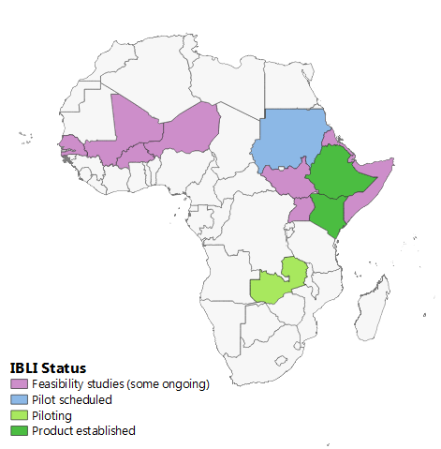
Results induced significant IBLI diffusion
Commercial policies in n. Kenya (2010) and s. Ethiopia (2012), sharia-compliant Takaful version in n. Kenya (2013)
Kenya gov’t nationwide through Kenya Livestock Insurance Program (2015)
WFP programs in Somali region, Ethiopia
(2019) and in Zambia (2021), pilot scheduled
for Sudan, expanding into Somalia, Djibouti.
Adapted for sovereign-level Africa Risk Capacity
(ARC) products for pastoral regions for Kenya,
Mauritania.
Feasibility studies ongoing in multiple countries.

Slide 11
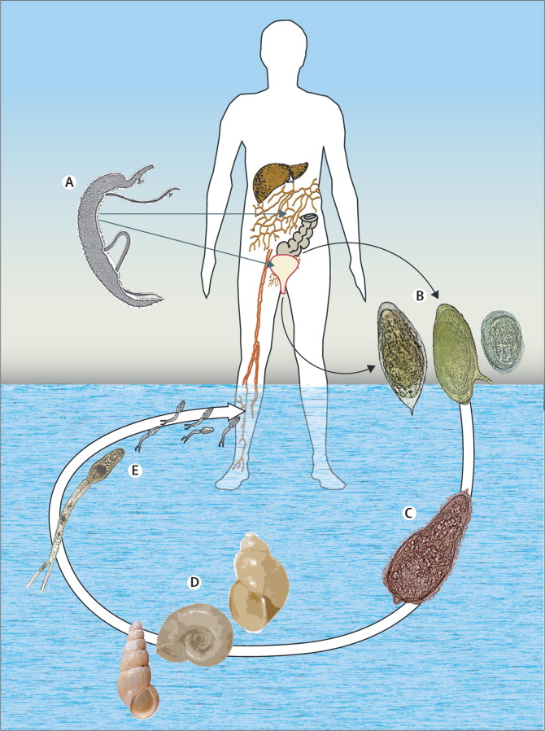
Example 2: Schistosomiasis in Senegal
Ag dev’t can aggravate infectious disease burdens.
Schistosomiasis/bilharzia affects >240mn globally (>800 mn at risk) in poor areas.
Great example of poverty-disease traps. Impedes child cognitive/physical dev’t via anemia, morbidity. Disrupts work/school attendance. Suppresses immunoresponse. Women stigmatized if infected.
Usual response: deworming (MDA of praziquantel) but high reinfection rates.
Biocontrols (e.g., prawns) largely ineffective
Source: Colley et al. The Lancet 2014

Slide 12
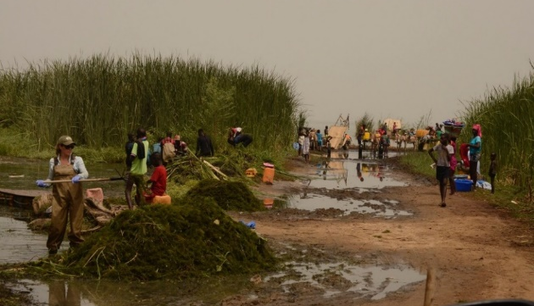
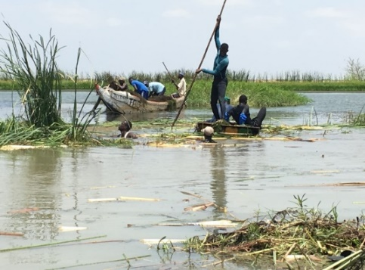
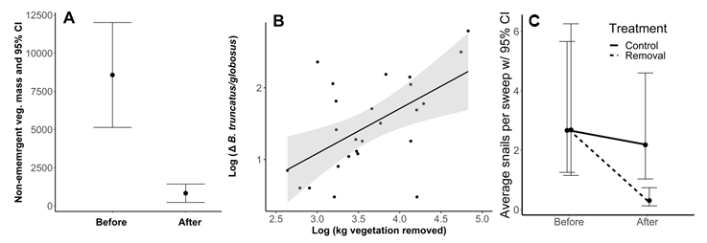
Risk mgmt. beyond IBLI: Schisto in Senegal
Novel remedy: clear snails’ preferred habitat: submerged Ceratophyllum demersum.
It works! Snails and infections (esp. S. mansoni) falls sharply.
Source: Rohr et al. (Nature 2023)

Slide 13
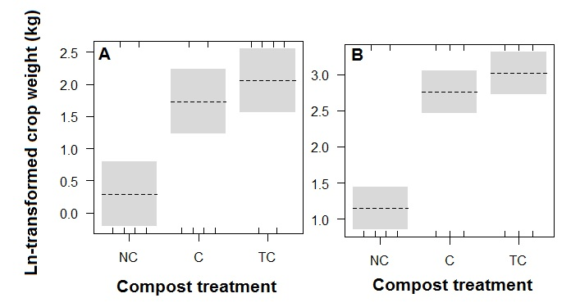
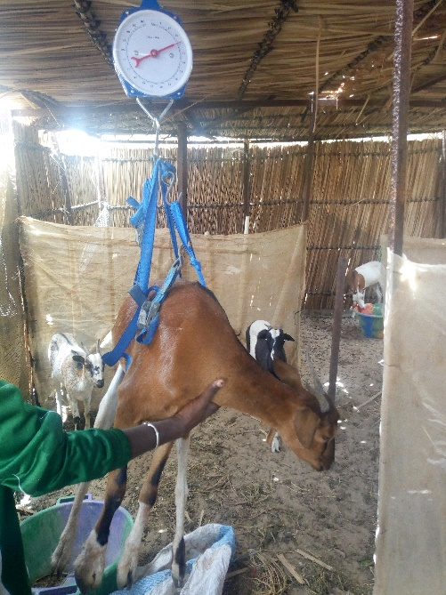
Risk mgmt. beyond IBLI: Schisto in Senegal
Enough private benefits to use of harvested C. demersum to induce voluntary removal?
Run preliminary crop compost / livestock feeding trials
Ln-transformed (+1) weight (kg) of pepper (A) and onion (B) by compost treatment (NC = no compost, C = compost, TC = tilled compost).
Benefit/cost estimates: 2.8 - 7.1
Source: Rohr et al. (Nature 2023)

Slide 14
What next on schisto in Senegal?
Running multi-year trial across 104 villages in Senegal now
Working on developing an alternative, commercial, mechanical approach to submerged aquatic vegetation removal.
Hopefully we learn more soon …

Slide 15
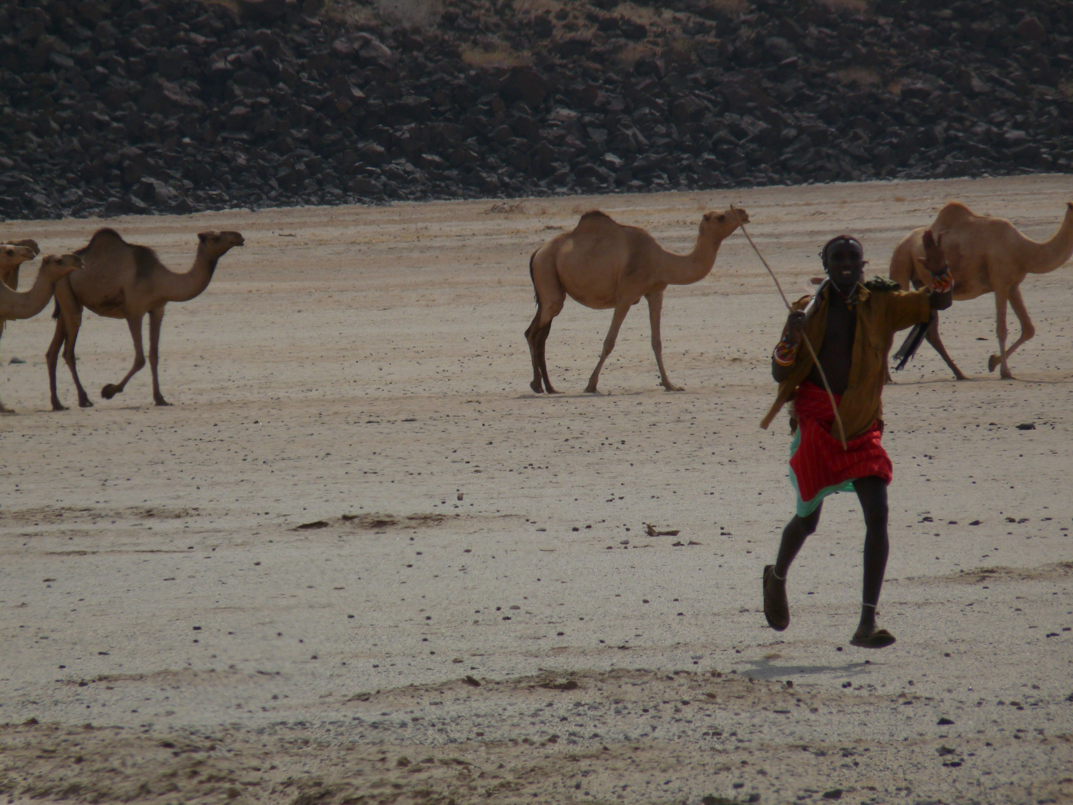
Uninsured catastrophic risk exposure is a key feature of the persistently poor. Even imperfect catastrophic risk management may help.
Thank you for your time and interest!
Notes:
15

